Slide 1
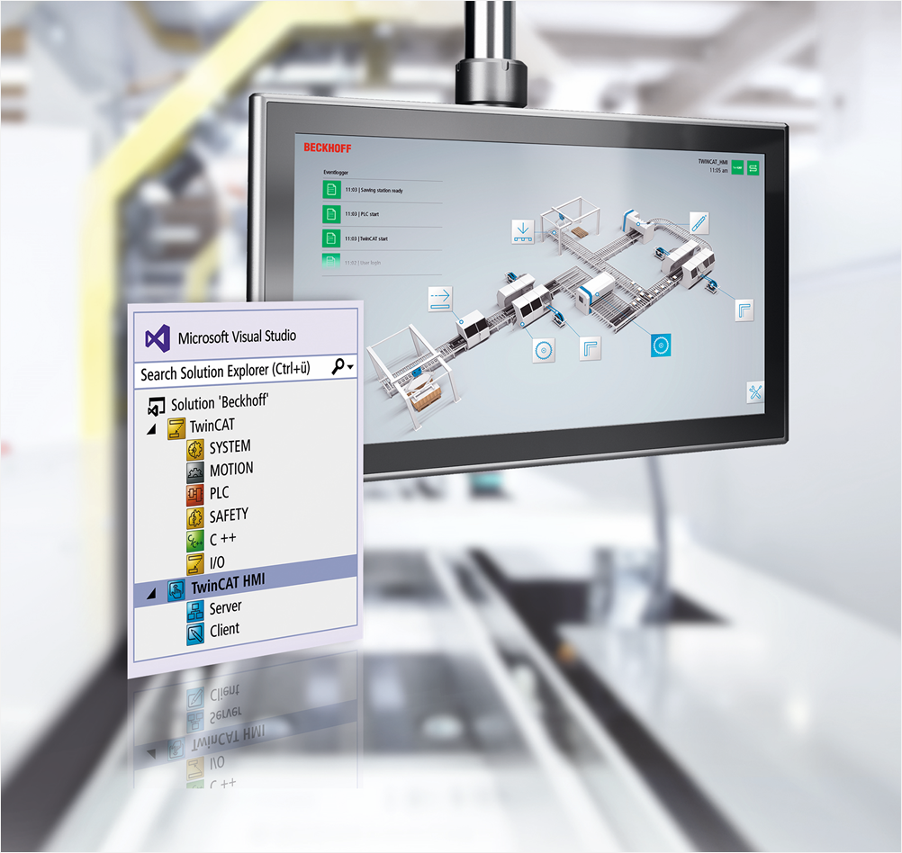
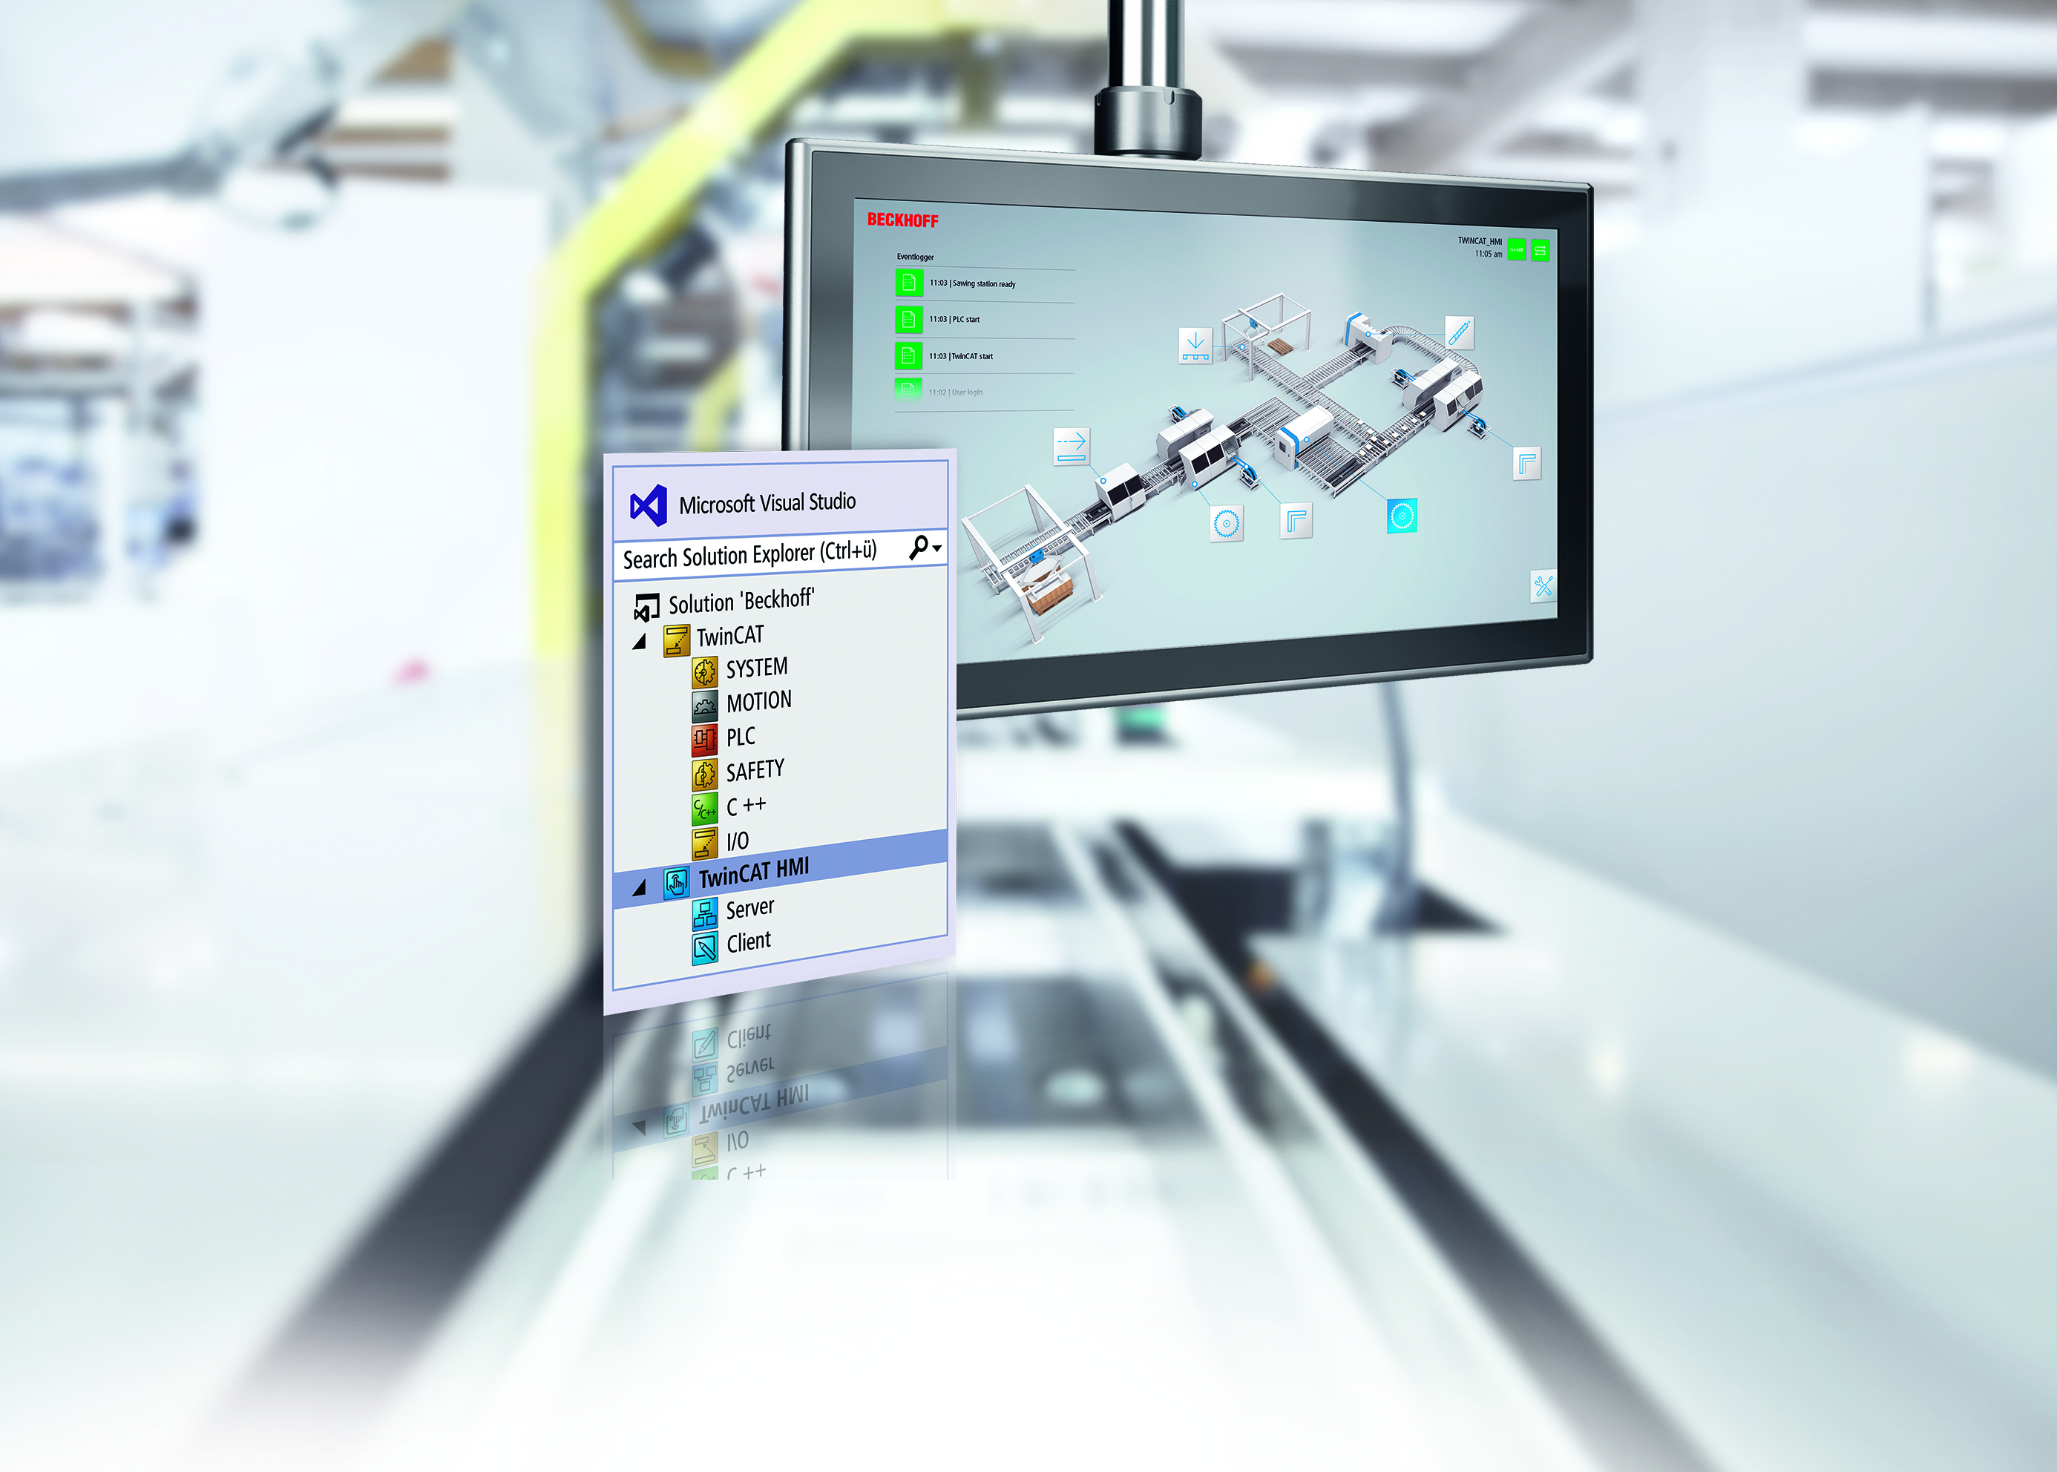
TwinCAT HMI

Slide 2
TwinCAT HMI Agenda
Introduction
Engineering
Architecture
Scenarios
Products
Features

Slide 3
TwinCAT HMI Agenda
Introduction
Engineering
Architecture
Scenarios
Products
Features

Slide 4

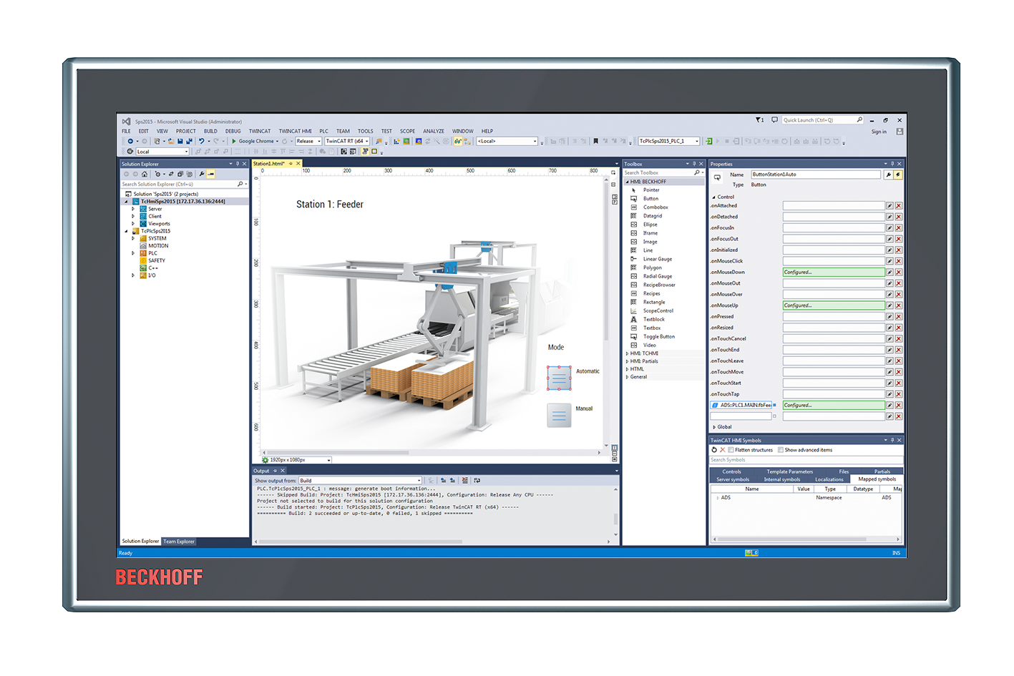

TwinCAT HMI | Introduction Technology
Plattform
independent
Responsive
Future-proof
Performant

Slide 5




TwinCAT HMI | Introduction Components
TwinCAT HMI Creator
TwinCAT HMI Framework
TwinCAT HMI Server
TwinCAT HMI Client (HTML5-Browser)

Slide 6
TwinCAT HMI Agenda
Introduction
Engineering
Architecture
Scenarios
Products
Features

Slide 7
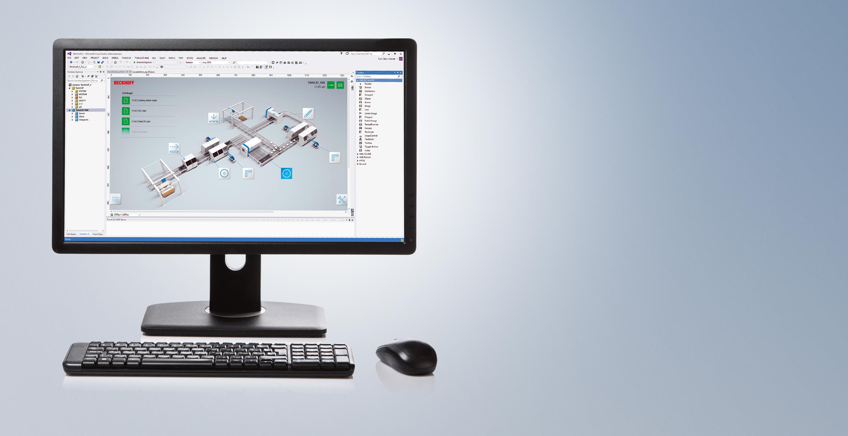
TwinCAT HMI | Engineering Visual Studio® Integration
One engineering tool
One solution for multiple projects (e.G. TwinCAT 3)
Source code control
Live engineering

Slide 8

TwinCAT HMI | Engineering WYSIWYG-Editor
Graphical editor
Creation via Drag & Drop possible
Standard controls
Create own Users controls
Actions and Conditions Editor
User Management
Language and unit Management
Recipe Management
Alarming

Slide 9
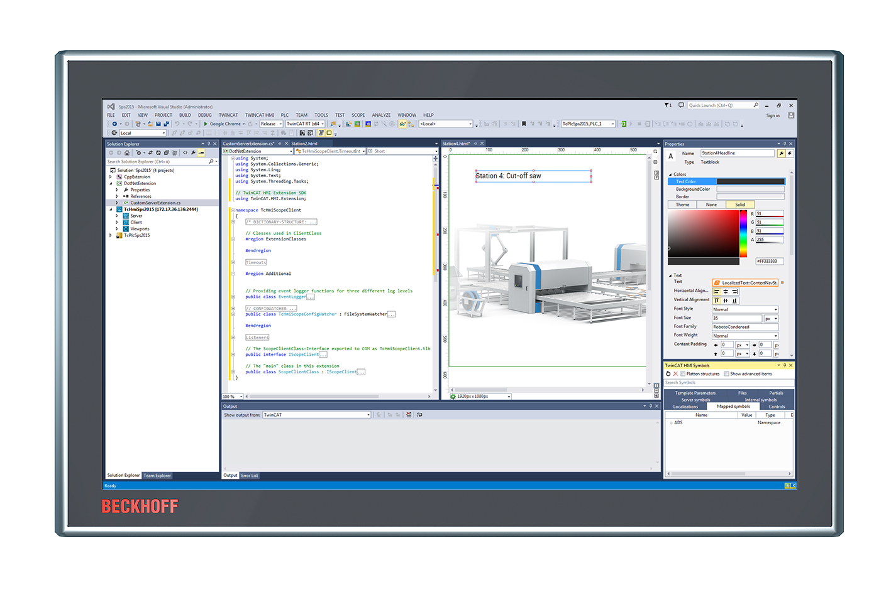
TwinCAT HMI | Engineering Extensibility
Framework Controls
JavaScript / TypeScript
3rd party
Server Extensions
C# .NET
C# .NET Core (VS2019)

Slide 10
TwinCAT HMI | Engineering Modular Engineering
View
Content
Content
Content
Standard
Control
User Control
Framework Control
View

Slide 11
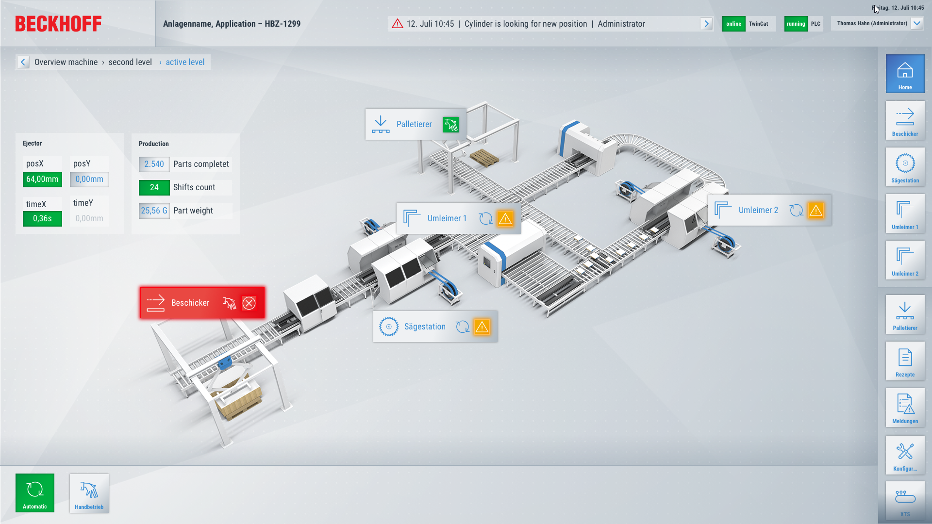
TwinCAT HMI | Engineering Project Templates
Integrate into TwinCAT HMI Engineering as VS project template
Developed by the Beckhoff design professionals
Preconfigured functionalities
User management (Client)
Event system
Theme selection
Application Template

Slide 12
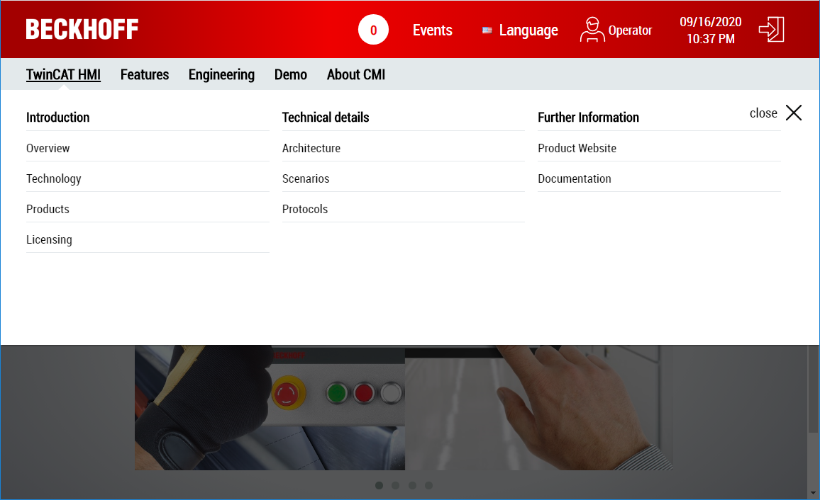
TwinCAT HMI | Engineering Project Templates
Web Navigation Template

Slide 13
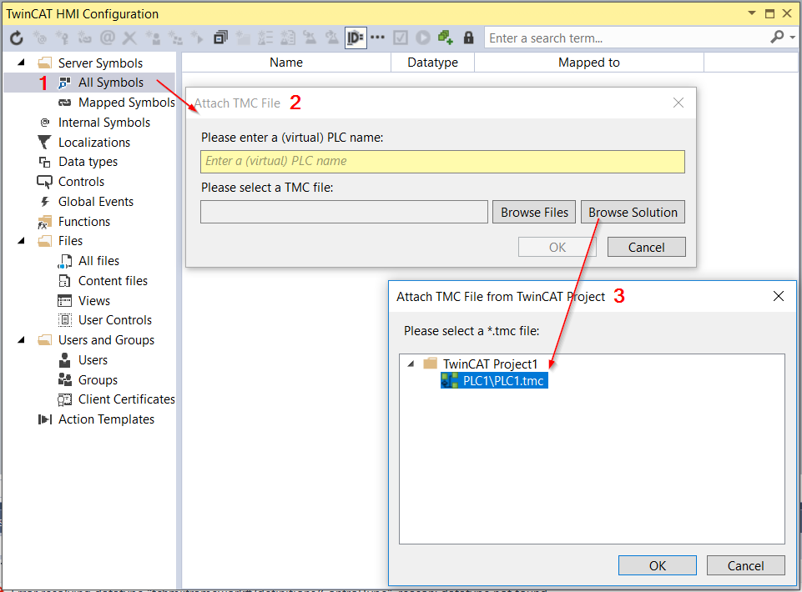
TwinCAT HMI | Engineering Variables
Online Engineering
Active ADS-Data available to map
Offline Engineering
TMC-Support for engineering without PLC connection
Load TMC-files and map variables offline
Switch to real PLC if connection is available

Slide 14
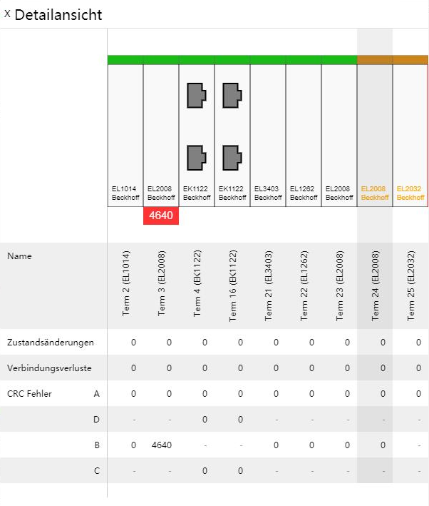
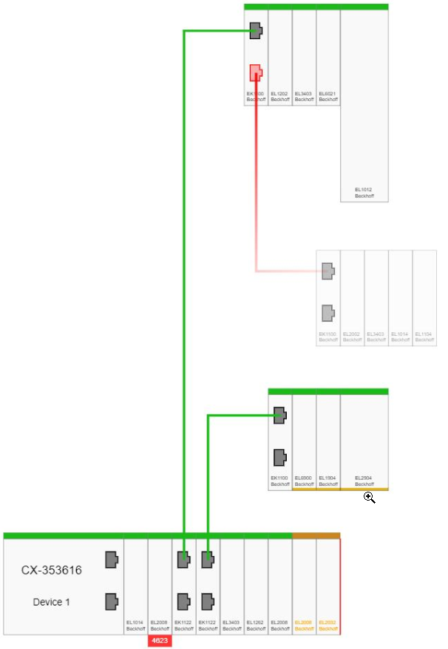
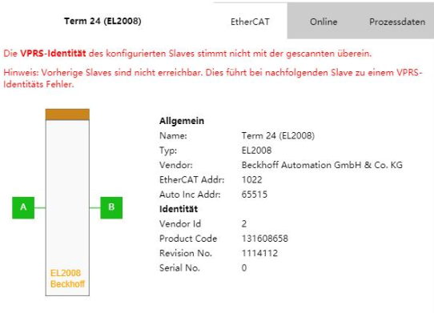
TwinCAT HMI | Engineering EtherCAT Diagnosis Control
Auto generated EtherCAT topology view for TwinCAT HMI
Provides detailed information of masters and slaves
Propose remedies in service case
Support features:
Hot Connect
Redundancy
Force process data inside the detail's popup
Included in TwinCAT HMI license

Slide 15
TwinCAT HMI | Engineering Eventlogger-Extension
Communication with TC3 Eventlogger
local targets
remote targets
Access to TwinCAT Eventlogger database
active alarms
historical alarms
Designed for EventGrid Control
included in TF2000 Server license
HMI Server
HMI Client
Eventlogger
Extension
EventGrid
Control
TwinCAT
EventLogger
DB
TC3 PLC
TC3 C++

Slide 16
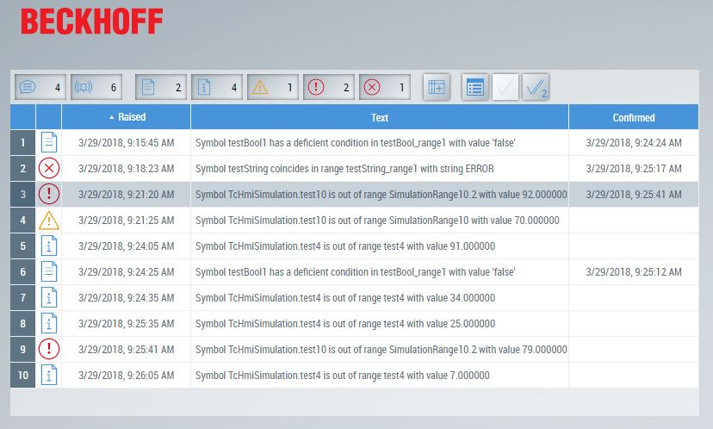
TwinCAT HMI | Engineering EventGrid-Control
Display of all HMI events
EventLogger-Extension
Alarm-Extension
Custom-Extension
Configurable filters
active and historical events
Multi-Language Support
User-Management Support
Event API available
HMI Server
HMI Client
Eventlogger
Extension
EventGrid
Control
Custom Server
Extension
Custom Framework Control

Slide 17
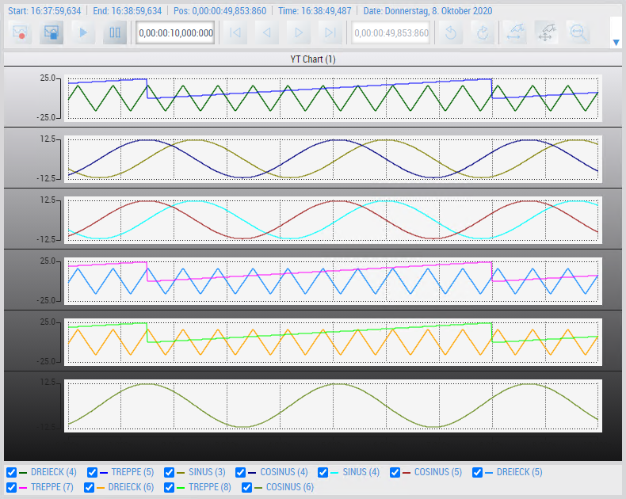
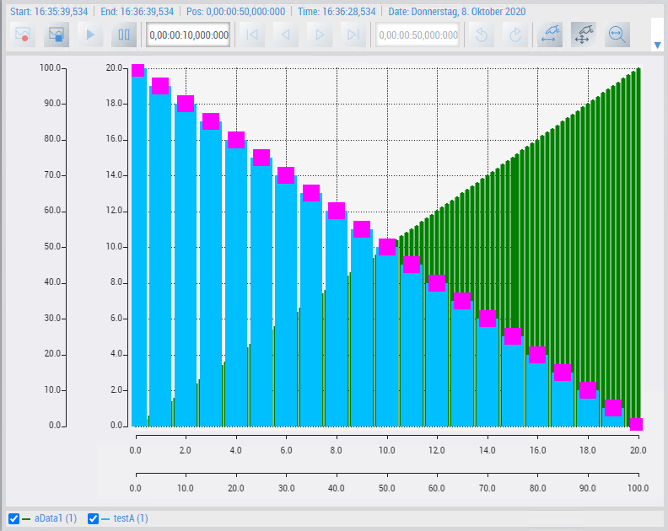
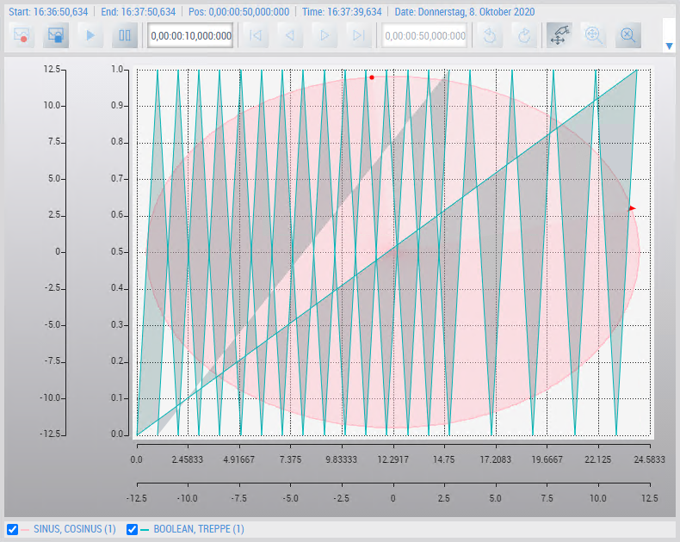
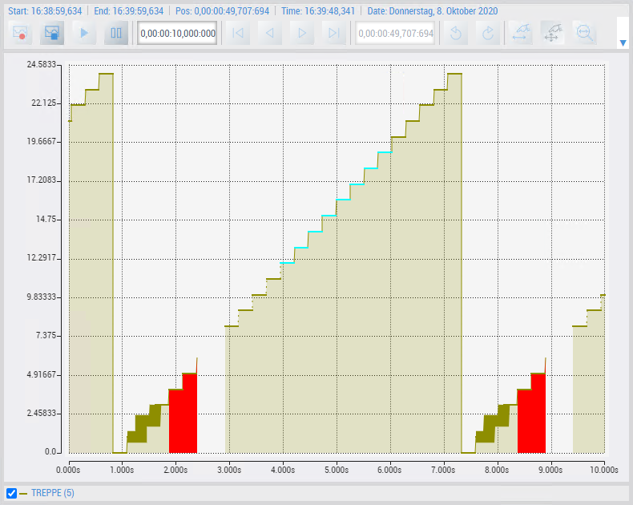
TwinCAT HMI | Engineering TwinCAT Scope Integration
Display of TwinCAT Scope Charts in HMI Client
Recording settings (start/stop)
Data analysis (zoom, move)
Available chart types: y(t), x(y), Bar, Array Bar
Import of existing Scope configurations
Included in HMI and Scope license

Slide 18
TwinCAT HMI Agenda
Introduction
Engineering
Architecture
Scenarios
Products
Features

Slide 19
TwinCAT HMI | Architecture Architecture in engineering
Visual Studio®
TwinCAT HMI
TwinCAT 3
TwinCAT HMI Creator
TwinCAT HMI Framework
System Manager
Programmierung
HTTP(S), WS(S)
TwinCAT HMI Server
TwinCAT HMI Server Extension
Events
User Management
Custom Extension
…
ADS
ADS
TwinCAT Runtimes

Slide 20
TwinCAT HMI | Architecture Architecture during runtime
TwinCAT HMI Client
TwinCAT HMI Project
TwinCAT HMI Framework
Pages
Logic
…
Controls
API
…
HTTP(S)
WS(S)
TwinCAT HMI Server
WWW Root
TwinCAT HMI Server Extension
Content
Framework
Protocols
Events
…
ADS
ADS
TwinCAT Runtimes
3rd Party Runtimes

Slide 21
TwinCAT HMI Agenda
Introduction
Engineering
Architecture
Scenarios
Products
Features

Slide 22
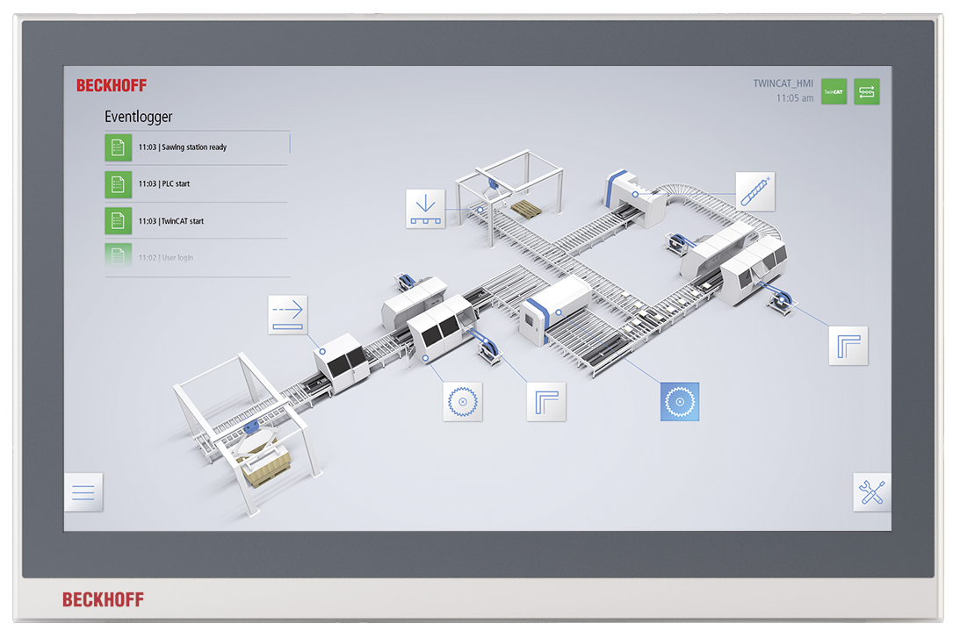
TwinCAT HMI | Scenarios Local client
Panel
DVI/USB
TwinCAT HMI Client
TwinCAT HMI Server
TwinCAT Runtime
PC

Slide 23
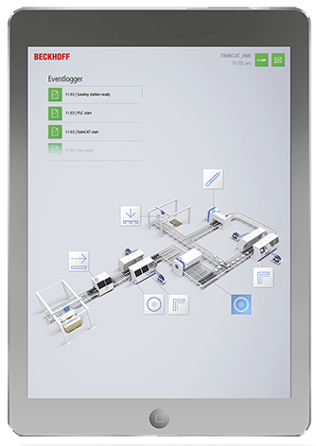
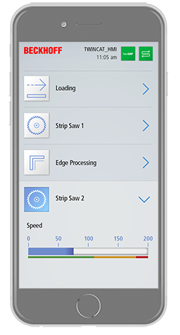
TwinCAT HMI | Scenarios Multi-client
Panel PC
Mobile Device
Mobile Device
TwinCAT HMI Client 1
TwinCAT HMI Client 2
TwinCAT HMI Client 3
WebSockets
TwinCAT HMI Client
TwinCAT HMI Server
TwinCAT Runtime
Panel PC

Slide 24
TwinCAT HMI | Scenarios Multi-runtime
Panel PC
Mobile Device
TwinCAT HMI Client 1
TwinCAT HMI Client 2
WebSockets
PC
TwinCAT HMI Server
ADS
PC
PC
PC
TwinCAT Runtime 1
TwinCAT Runtime 2
TwinCAT Runtime n

Slide 25
TwinCAT HMI | Scenarios Multi-server
Panel PC
TwinCAT HMI Client 1
TwinCAT HMI Server
WebSockets
TwinCAT HMI Server 1
TwinCAT HMI Server 2
TwinCAT HMI Server n
PC
PC
PC
TwinCAT Runtime 1
TwinCAT Runtime 2
TwinCAT Runtime n

Slide 26











TwinCAT HMI | Scenarios Multi-protocol
Panel PC
Panel PC
TwinCAT HMI Client
TwinCAT HMI Client
TwinCAT HMI Server
HTTP(S), WS(S)
TwinCAT HMI Server Extensions
Protocols
Events
Users
…
Custom…
I/O
PLC
C++
Functions
3rd Party
3rd Party…
IoT
…
Analytics
...

Slide 27
TwinCAT HMI Agenda
Introduction
Engineering
Architecture
Scenarios
Products
Features

Slide 28
TwinCAT HMI | Products Products
TE2000 TC3 HMI Engineering
HMI Engineering environment integrated in Visual Studio
TF2000 TC3 HMI Server
One Client (Browser) and one Target (ADS) connection integrated
TF20x0 TC3 HMI Clients Pack
Extension of the number of concurrent client connections
TF20x0 TC3 HMI Targets Pack
Extension of the number of concurrent target connections

Slide 29
TwinCAT HMI | Products Products
TF2110 TC3 HMI OPC UA
Vendor-independent communication protocol
TF2200 TC3 HMI Extension SDK
Integration of custom .NET business logic
TF2300 TC3 HMI Scope
Integration of TwinCAT Scope

Slide 30

TwinCAT HMI | Products Business Model
Licensing is not based on the number of tags!
HMI Engineering is free of charge
Including updates and support
Licensing is based on
Platform level (like TC3) of TC HMI Server
Amount of clients and targets
No count of tags
Optional
TF2000 HMI Server
TF20x0 Clients Pack
Includes:
- 1 Client (Browser)
- 1 Target (NetId)
1 / 2 / 3 / 5 / 10 / 20 / 25 / 100
HMI Extensions
+
+
=
TF20x0 Targets Pack
Scope, OPC UA, …
TwinCAT 3 HMI License
1 / 2 / 3 / 5 / 10 / 20 / 25 / 100

Slide 31
TwinCAT HMI Agenda
Introduction
Engineering
Architecture
Scenarios
Products
Features

Slide 32
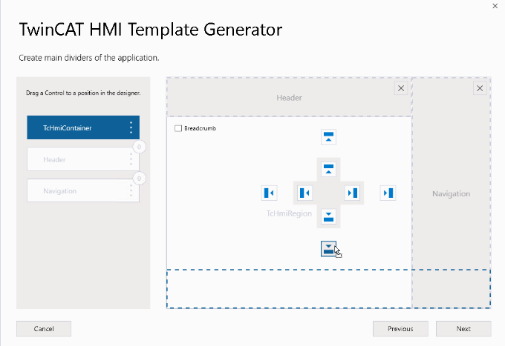

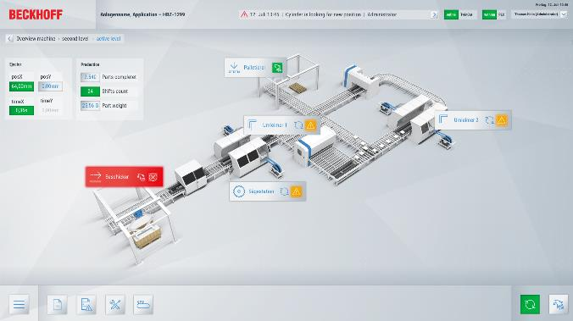
TwinCAT HMI | Features Project Generator
Graphical configurator
Different templates
Fixed resolution or responsive
Configure layout and navigation
UX design by experts
Preconfigured functionalities
User management (Client)
Event system
Theme selection
TwinCAT HMI | Features

Slide 33
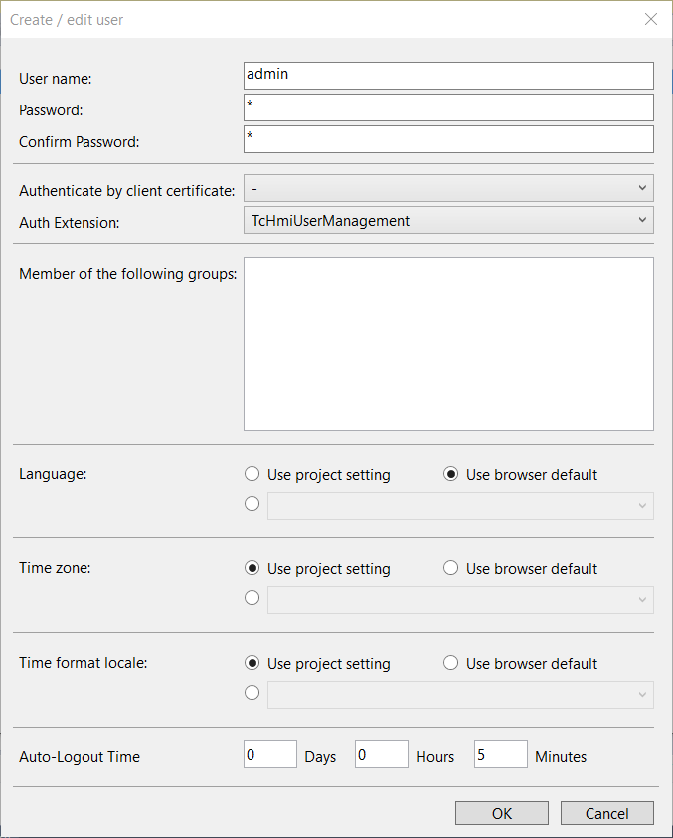
TwinCAT HMI | Features User Management
User Management server extension integrated
Create user groups and users
Dynamic editing and addition of users
User Management front-end control
Default Login page editable & option to add new custom login page
Permissions for controls, symbols, files
Complex controls can have permissions for individual nested controls

Slide 34
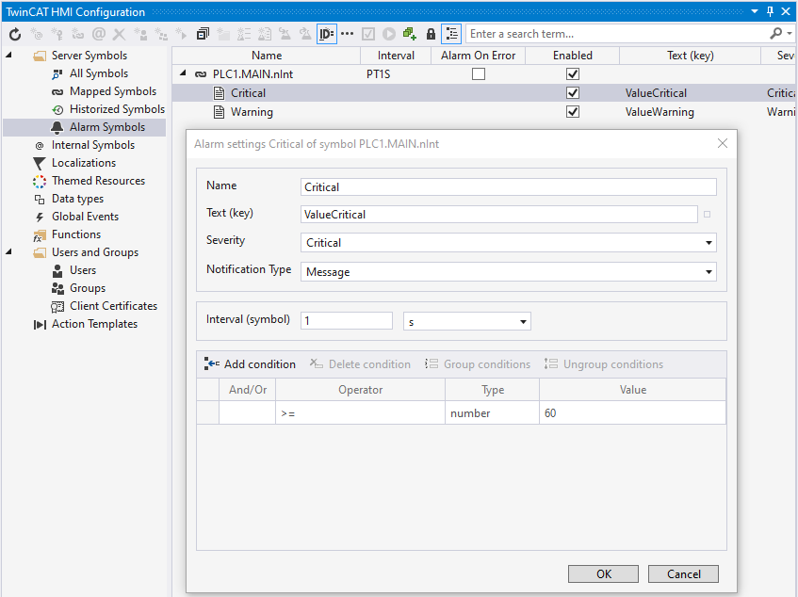
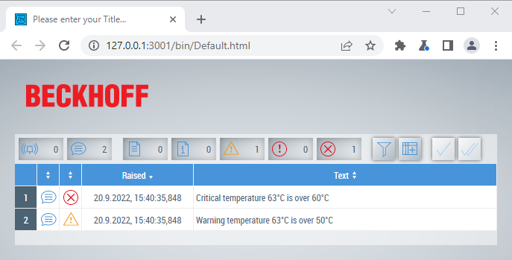
TwinCAT HMI | Features Alarm Extension
Use a symbol to generate an alarm
ADS
OPC UA
Custom Server Extension
EventGrid & EventLine support
Localized text support
Integrated in HMI Server
no running server, no events
update rate in fixed interval time

Slide 35
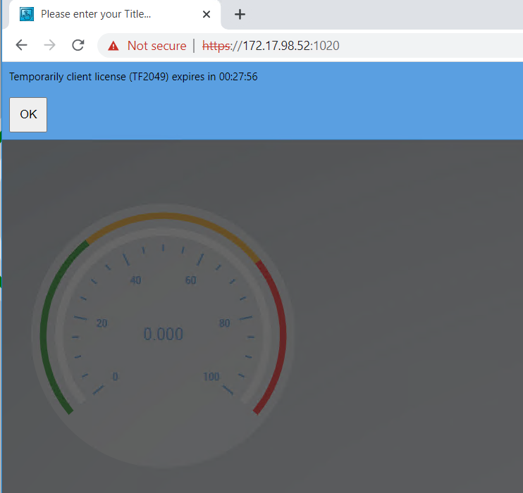
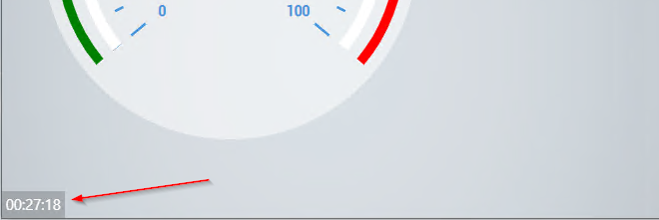
TwinCAT HMI | Features Time-based client license
New TF2049 „Time Based Clients“ license
Free of charge
Use Case
Maintenance
temporary single client access if max. clients are reached
Limitations:
30 minutes access
5 minutes block time
countdown and banner
warning 5 minutes before block time

Slide 36
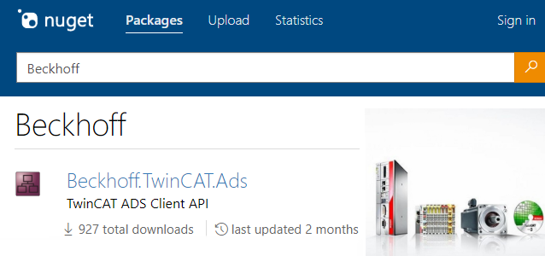
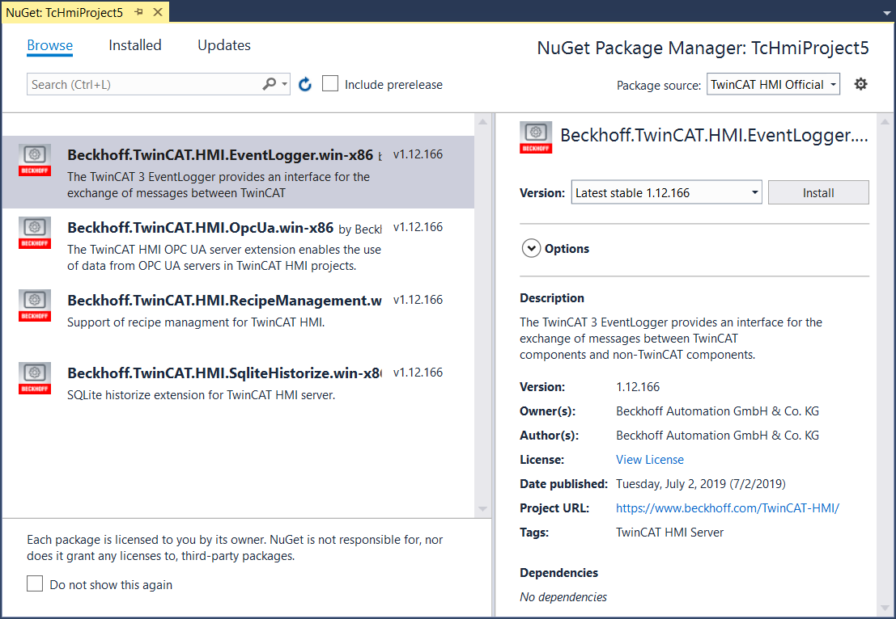
TwinCAT HMI | Features Package Management
Based on Microsoft NuGet
Create libraries for
Controls
Extensions
Functions and CodeBehinds
Images and Css-Files
Create dependencies between packages
Share packages internal or external
Easier Update Management

Slide 37
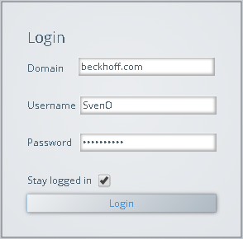

TwinCAT HMI | Features LDAP Extension
Support of Lightweight Directory Access Protocol
Connection to central user management (Active Directory)
Use OS credentials to log into HMI client
Transparent use by group mappings
HMI Client
Group mappings
HMI Groups | LDAP Groups
Engineers | COMPANY\Engineers
Operators | COMPANY\Operators
Company.com
HMI Usermanagement
Active Directory
UserXY
HMI Server
HMI LDAP
Extension
LDAP
Server

Slide 38
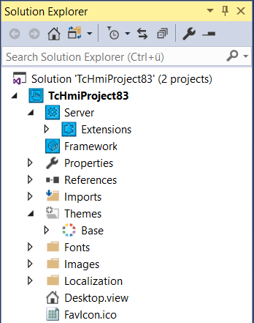


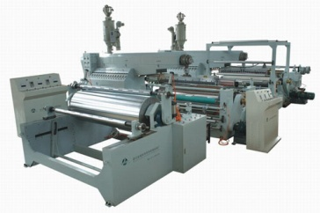
TwinCAT HMI | Features Automation Interface
Automatic generation of TcHmi projects
Comparable to TwinCAT Automation Interface
API to access most the engineering functions
Program language independent – based on COM
Use Cases:
Automatic HMI deployment
Series machine builders
Project generation based on PLC code
…
create TcHmi project
deploy project on target Server
Automated task or plugin

Slide 39


TwinCAT HMI | Features TypeScript Support
Added TypeScript support to TcHmi (superset of JavaScript)
Use TypeScript for
Framework Controls
Code Behind files
Functions
Development in JavaScript also possible
Benefits:
Type-safe
Easier and faster development
Higher flexibility

Slide 40
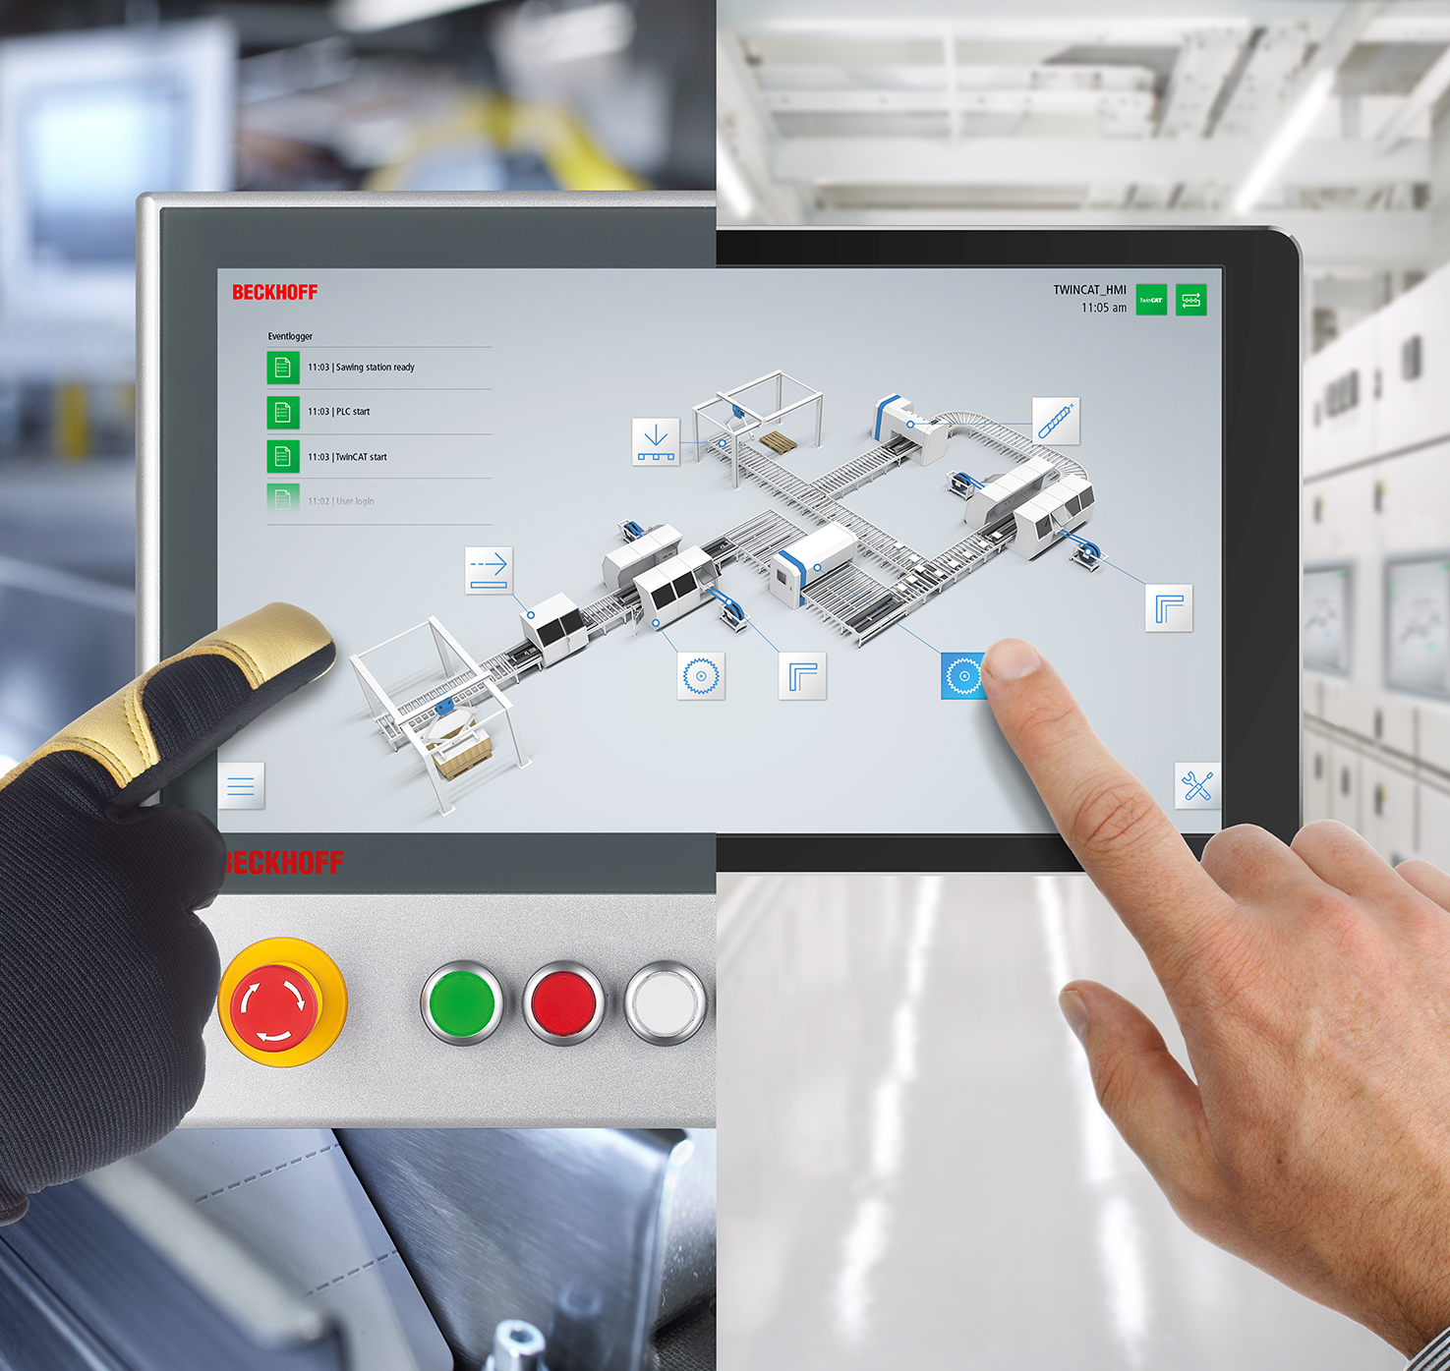
TwinCAT HMI Highlights
Efficient engineering
Web-based
HTML5, JavaScript, TypeScript
Platform independence
Flexible architecture
Modular extensibility
Cloud Machine Interface

Slide 41
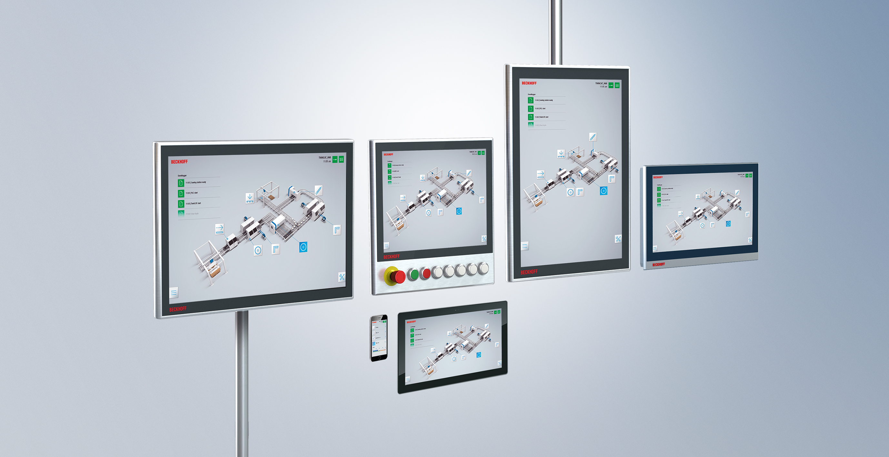
TwinCAT HMI Questions?

